Slide 1
Signal Webinar

Slide 2
Make sure you get paid what you are worth, and look after what you earn …. small changes, BIG results
Real examples based on many years of providing financial advice
One of the bias of human nature

Slide 3
Sir John Harvey Jones

Slide 4
So we have developed a 7 step system
Regularly measuring the stuff that matters
Identifying the issues and opportunities
Exploring possibilities
Creating an improvement action plan
Testing new ideas and measuring their impact – i.e. sales lead conversion rate – change to script, price or guarantees – measure the impact to see if it works
Building on what works – and we build them into our system so we do it every time
Constantly moving the business forward – the compound effect is we build a better business

Slide 5
Heart of the system is the measurement of the numbers that matter
Conversion rates …..
At the heart of our system is three sheets of A4 paper
My assertion
Simplicity
Better set of outcomes

Slide 6
Client ABC
 | PY | CY
 | £ | £
Sales | 1,116,221 | 1,034,451
Cost of Sales | 937,832 | 835,748
Total Cost of sales | 937,832 | 835,748
Gross Profit | 178,389 | 198,703
Gross Profit % | 16.0% | 19.2%
Overheads | 33,017 | 33,340
Total Overheads | 33,017 | 33,340
Net Profit | 145,372 | 165,363
Net Profit % | 13.0% | 16.0%
All looks good… healthy profit
But what does the true numbers reveal – so we produce our one page BENCHMARK REPORT

Slide 7
A4 piece of paper number 1
Benchmarking

Slide 8
Benchmarking Report
Client ABC
Benchmarking | PY | CY |  | Benchmark |  | POTENTIAL
 | £ | £ |  |  |  | £
Sales | 1,116,221 | 1,034,451 |  |  |  | 1,134,302
Cost of Sales | 937,832 | 835,748
Adjustment for Commercial Salaries + ANO | 94,380 | 94,380
Total Cost of sales | 1,032,212 | 930,128 |  |  |  | 930,128
Gross Profit | 84,009 | 104,323 |  |  |  | 204,174
Gross Profit % | 7.5% | 10.1% |  | 18.0% |  | 18.0%
Overheads | 33,017 | 33,340
Adjustment for Commercial Salaries + ANO | 36,400 | 36,400
Total Overheads | 69,417 | 69,740
Net Profit | 14,592 | 34,583 |  | Missing Profit |  | 99,851
Net Profit % | 1.3% | 3.3%
Key RATIOS
Sales growth |  | -7% |  | 7%
Average employee cost | 7,410 | 8,429 |  | n/a
Sales per employee | 558,111 | 413,780 |  | n/a
Gross profit margin | 7.5% | 10.1% |  | 18.0%
Net profit margin | 1.3% | 3.3% |  | 5% - 7.5%
Working capital | 19,953 | 94,820 |  | £125,000
Current ratio | 1.22 | 1.84 |  | 1.5 - 2
Debt servicing |  |  |  | 4.5
Completeness of income

Slide 9
Systems – Systemise your business
Better work life balance & empower your team
Recruit people who buy in
Build your systems
Consistently deliver
Apprentices
If taking control

Slide 10
Systems – Systemise your business

Slide 11
Your sales system

Slide 12
 |  |  | Success Driver Map - Specific Model
 |  |  | Impact of action plan |  |  |  | 0% |  | £0
 |  |  | Repeat |  |  |  |  |  | New |  |  | Action plan
 |  |  | business |  |  |  |  |  | business
 |  |  | 100 | @ | 20% |  |  |  | 711
 |  |  | Customers |  | Re-enquiry rate |  |  |  | Leads
 |  |  |  | Sale | 731 | @ | £0 | = | £0
 |  |  | Enquiries | Cost | 731 | @ | £0 | = | £0
 |  |  |  | Margin |  |  |  | = | £0
 |  |  | Meeting rate |  |  | = | 90%
 |  |  |  | Sale | 658 | @ | £0 | = | £0
 |  |  | Meetings | Cost | 658 | @ | £0 | = | £0
 |  |  |  | Margin |  |  |  | = | £0
 |  |  | Quote rate |  |  | = | 95%
 |  |  |  | Sale | 625 | @ | £0 | = | £0
 |  |  | Quotes | Cost | 625 | @ | £0 | = | £0
 |  |  |  | Margin |  |  |  | = | £0
Win rate |  |  | = | 80%
 | Sale | 500 | @ | £0 | = | £0
Jobs | Cost | 500 | @ | £100 | = | £50,000
 | Margin |  |  |  | = | -£50,000
Average value of a job |  |  | = | £200
 | Sale | 500 | @ | £200 | = | £100,000
Sales | Cost | 500 | @ | £0 | = | £0
 | Margin |  |  |  | = | £100,000
Gives results of….
 | Sales |  |  |  |  | £100,000
 | Variable (activity) costs |  |  |  |  | £50,000
Results | Margin |  |  |  |  | £50,000
 | Other costs |  |  |  |  | £20,000
 | Profit |  |  |  |  | £30,000 |  | Change in profits |  |  | £0
 |  |  |  |  |  |  |  | Profit before changes |  |  | £30,000

Slide 13
Email folders
Enquiries received
Meetings
Quotes issued
Quotes accepted
Quotes lost
To invoice
Completed jobs

Slide 14
 |  |  | Success Driver Map - Specific Model
 |  |  | Impact of action plan |  |  |  | 28% |  | £8,500
 |  |  | Repeat |  |  |  |  |  | New |  |  | Action plan
 |  |  | business |  |  |  |  |  | business
 |  |  | 100 | @ | 20% |  |  |  | 711
 |  |  | Customers |  | Re-enquiry rate |  |  |  | Leads
 |  |  |  | Sale | 731 | @ | £0 | = | £0
 |  |  | Enquiries | Cost | 731 | @ | £0 | = | £0
 |  |  |  | Margin |  |  |  | = | £0
 |  |  | Meeting rate |  |  | = | 100%
 |  |  |  | Sale | 731 | @ | £0 | = | £0
 |  |  | Meetings | Cost | 731 | @ | £0 | = | £0
 |  |  |  | Margin |  |  |  | = | £0
 |  |  | Quote rate |  |  | = | 100%
 |  |  |  | Sale | 731 | @ | £0 | = | £0
 |  |  | Quotes | Cost | 731 | @ | £0 | = | £0
 |  |  |  | Margin |  |  |  | = | £0
Win rate |  |  | = | 80%
 | Sale | 585 | @ | £0 | = | £0
Jobs | Cost | 585 | @ | £100 | = | £58,500
 | Margin |  |  |  | = | -£58,500
Average value of a job |  |  | = | £200
 | Sale | 585 | @ | £200 | = | £117,000
Sales | Cost | 585 | @ | £0 | = | £0
 | Margin |  |  |  | = | £117,000
Gives results of….
 | Sales |  |  |  |  | £117,000
 | Variable (activity) costs |  |  |  |  | £58,500
Results | Margin |  |  |  |  | £58,500
 | Other costs |  |  |  |  | £20,000
 | Profit |  |  |  |  | £38,500 |  | Change in profits |  |  | £8,500
 |  |  |  |  |  |  |  | Profit before changes |  |  | £30,000

Slide 15
 |  |  | Success Driver Map - Specific Model
 |  |  | Impact of action plan |  |  |  | 97% |  | £28,960
 |  |  | Repeat |  |  |  |  |  | New |  |  | Action plan
 |  |  | business |  |  |  |  |  | business
 |  |  | 100 | @ | 20% |  |  |  | 711
 |  |  | Customers |  | Re-enquiry rate |  |  |  | Leads
 |  |  |  | Sale | 731 | @ | £0 | = | £0
 |  |  | Enquiries | Cost | 731 | @ | £0 | = | £0
 |  |  |  | Margin |  |  |  | = | £0
 |  |  | Meeting rate |  |  | = | 100%
 |  |  |  | Sale | 731 | @ | £0 | = | £0
 |  |  | Meetings | Cost | 731 | @ | £0 | = | £0
 |  |  |  | Margin |  |  |  | = | £0
 |  |  | Quote rate |  |  | = | 100%
 |  |  |  | Sale | 731 | @ | £0 | = | £0
 |  |  | Quotes | Cost | 731 | @ | £0 | = | £0
 |  |  |  | Margin |  |  |  | = | £0
Win rate |  |  | = | 90%
 | Sale | 658 | @ | £0 | = | £0
Jobs | Cost | 658 | @ | £100 | = | 65,800
 | Margin |  |  |  | = | -£65,800
Average value of a job |  |  | = | £220
 | Sale | 658 | @ | £220 | = | £144,760
Sales | Cost | 658 | @ | £0 | = | £0
 | Margin |  |  |  | = | £144,760
Gives results of….
 | Sales |  |  |  |  | £144,760
 | Variable (activity) costs |  |  |  |  | £65,800
Results | Margin |  |  |  |  | £78,960
 | Other costs |  |  |  |  | £20,000
 | Profit |  |  |  |  | £58,960 |  | Change in profits |  |  | £28,960
 |  |  |  |  |  |  |  | Profit before changes |  |  | £30,000

Slide 16
Completeness of income
Really important
Could be email folders
First client

Slide 17
Final bit on systems – Technology Automation
Scan in purchase invoices
Automate the production and distribution of repeating sales
Automate the chasing of money that your clients owe you

Slide 18
Only 8 ways to improve the profitability of any business – 3 relate to costs
Generate more sales leads
Convert more leads into customers
Get customers to stay with you for longer
Get them to buy more often
Get your existing customers to spend more each time

Slide 19
Pricing
Reducing
The way you price

Slide 20
Pricing methods
Time * Day Rate = Price
Value Pricing
Menu Pricing

Slide 21
How to set your day rates

Slide 22
Client ABC
Rate Calculator |  | INPUT
Hours per day |  | 8
Days per year |  | 260
Less holidays, bank holidays, training, sickness |  | 40
Productive days |  | 220
Team Utilisation rate |  | 95%
Team working days |  | 209
Employers National Insurance |  | 10.00%
Value of subcontracted work that is marked-up |  | 50,000
Mark up applied to subcontracted work |  | 25%
 |  | 12,500
Subcontracted return |  | 20%
Company overheads |  | 100,000
Profit return on fee income |  | 20.0%

Slide 23
Client ABC
The Team
 | Builders
Number | 3
Name of Employee | 28,800
Ers NI | 2,880
Total | 31,680
Cost to you | 152
Hourly rate | 19
Overheads | 20
Profit | 10
Rate to the Client | 49 | Day rate | 392
Margin Return | 61%

Slide 24
Client ABC |  |  |  | The Results
 |  |  |  |  | Fee Revenue |  | Sub Contract |  | Total
Revenue |  |  |  |  | 243,800 |  | 62,500 |  | 306,300
Direct costs |  |  |  |  | 95,040 |  | 50,000 |  | 145,040
Gross Profit |  |  |  |  | 148,760 |  | 12,500 |  | 161,260
Gross Profit % |  |  |  |  | 61.02% |  | 20.00% |  | 52.65%
Overheads |  |  |  |  | 100,000 |  |  |  | 100,000
Profit |  |  |  |  | 48,760 |  | 12,500 |  | 61,260
Profit % |  |  |  |  | 20.00% |  | 20.00% |  | 20.00%
Current sales value |  |  |  |  | 200,000
Sales left on the table |  |  |  |  | 106,300

Slide 25
Customers Aren’t Price Sensitive They are Value Sensitive
Your price depends on
The Value You create
How you can differentiate yourself from your competition
Your Own Confidence in that value
Conversation You are willing to have
If you can add in more value you can charge higher prices

Slide 26
Cost doesn’t determine the value & price
It’s the value that determines the cost
How can you add more value
Definition of value pricing

Slide 27
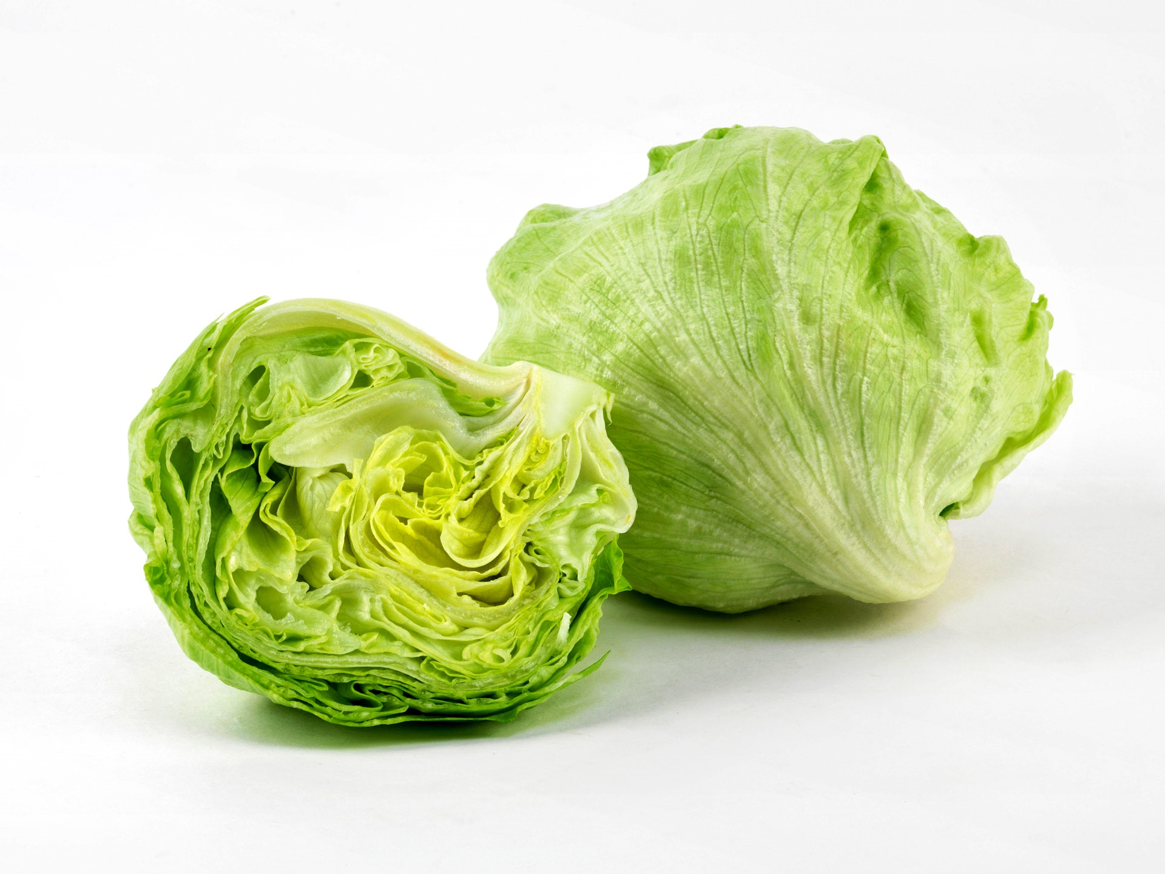
Methods of increasing your price

Slide 28
The easiest way to make more money is to get your price right
Different customers will pay different prices
If you have a single price its either too high or too low
So charge different customers different prices

Slide 29
Customers |  | Willing |  | Price |  | Unit |  | Profit
 |  | to Pay |  | Charged |  | Costs
90 |  | £5 |  | £5 |  | £4 |  | £90
10 |  | £10 |  | £5 |  | £4 |  | £10
 |  |  |  |  |  | Total Profit |  | £100
90 |  | £5 |  | £5 |  | £4 |  | £90
10 |  | £10 |  | £10 |  | £4 |  | £60
 |  |  |  |  |  | Total Profit |  | £150

Slide 30
Building on this then look to offer 3 different levels of service at 3 different price points
We call this Menu pricing

Slide 31
Menu Pricing allows you to put 3 different prices on the table
So if we can find different ways to charge different customers different prices we will maximise our profits
Reason to do this is that people put different values on different prices – by offering 3 prices you start to maximise the value you get. It allows you to find out the price they are prepared to pay.
Offering 3 levels of services each with a different price
Coffee shops do it with small, regular and large
Bike repair shops do it with bronze, silver and gold

Slide 32
So pulling all this together the 3 prices could be set as follows
Entry price – based on time and day rate – this is what you would have got paid if you were just putting one price on the table
Middle price – based on the above but extra value is added to this package so your prices are say 30% higher
Top price – based on the above – again adding in even more value so this price may be set at twice the level of the entry level price
This will allow prospects to choose the package that is most appropriate to them – they can get what they want and you get to maximise your income

Slide 33
Don’t bet the business…
…test everything

Slide 34
The right Corporate Structure and Taxation
60% rate
Self employed and 40% tax
Research and Development tax credits
IHT tax will be payable if you don’t have a will
Kids at university
Partnership
Review the structure each year to see it is still the best structure for you

Slide 35
Our final piece of A4 Paper – The One Page Plan
Key piece of paper
Evolved
The majority of the world’s

Slide 36
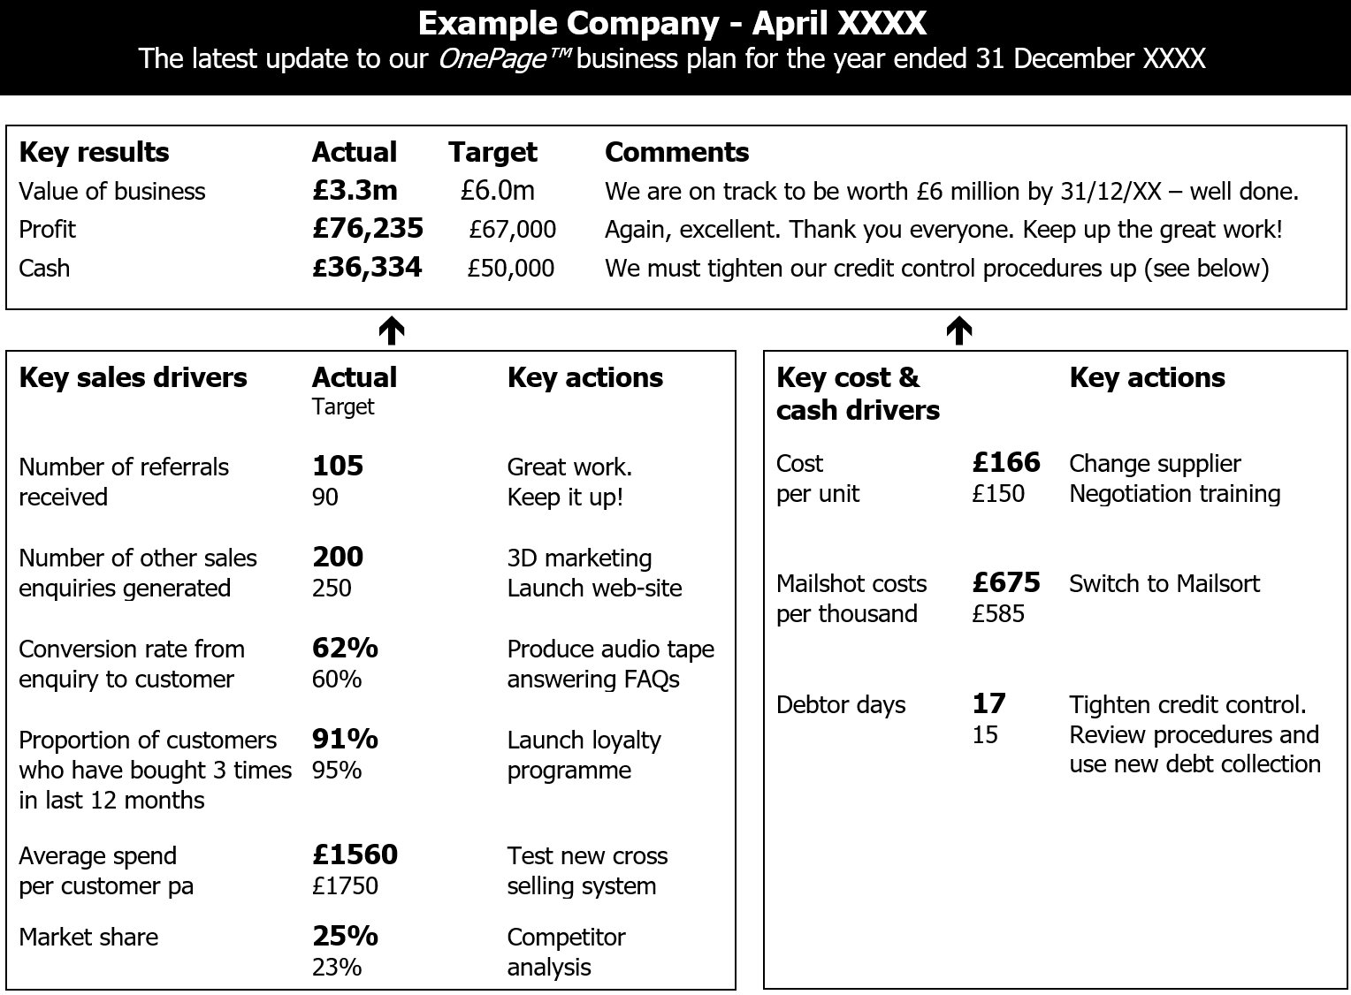
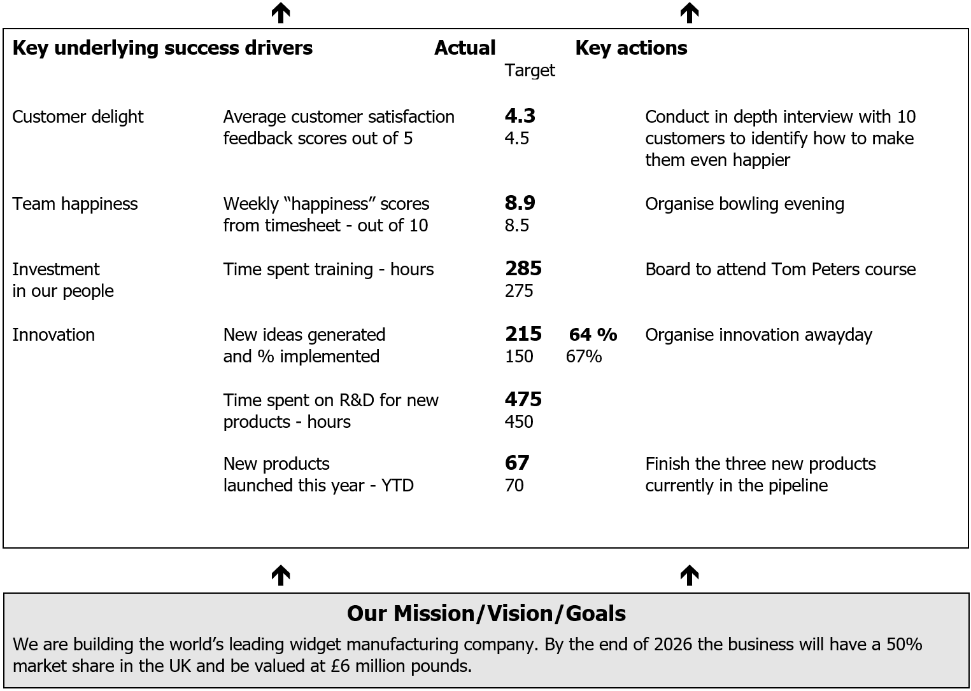
One Page Plan

Slide 37
Our final piece of A4 Paper – The One Page Plan
If you had
Wrap around
Improvement of just £10k

Slide 38
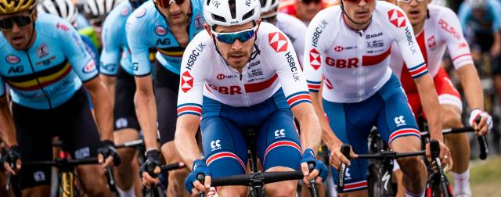
So our system is designed to
Measure the numbers that matter to help you build a better business and a better life
Marginal Gains for Maximum Effect
To improve

Slide 39
Impact
Client ABC
Benchmarking
 | PY | CY |  | Benchmark
 | £ | £
Sales | 1,116,221 | 1,034,451
Cost of Sales | 937,832 | 835,748
Adjustment for Commercial Salaries + ANO | 94,380 | 94,380
Total Cost of sales | 1,032,212 | 930,128
Gross Profit | 84,009 | 104,323
Gross Profit % | 7.5% | 10.1% |  | 18.0%

Slide 40
Impact
Success driver story
Chasing of money owed to them

Slide 41
What our clients say of our system
You have helped us supercharge the growth of our business by understanding what is really going on in our business, what is and isn’t working so we can evolve our strategy – you provide a tool to help us grow faster, make better decisions and ensure we don’t waste as much money.
You aren’t any accountant, more management accountant, help us manage, run and prepare our accounts. You help us shape up everything in the business financially. Traditional accountant tells you your tax bill 9 months after year end at the last minute. Stop looking in the rear view mirror, start seeing it now, don’t sit and wait You are the PWC for small owner managed business, you don’t need to be a global company to get a really good accountant.
Small enough where it is personal but large enough you can take care of all our needs. Everyone is on our side, it’s good fun and we have a laugh along the way

