Slide 1
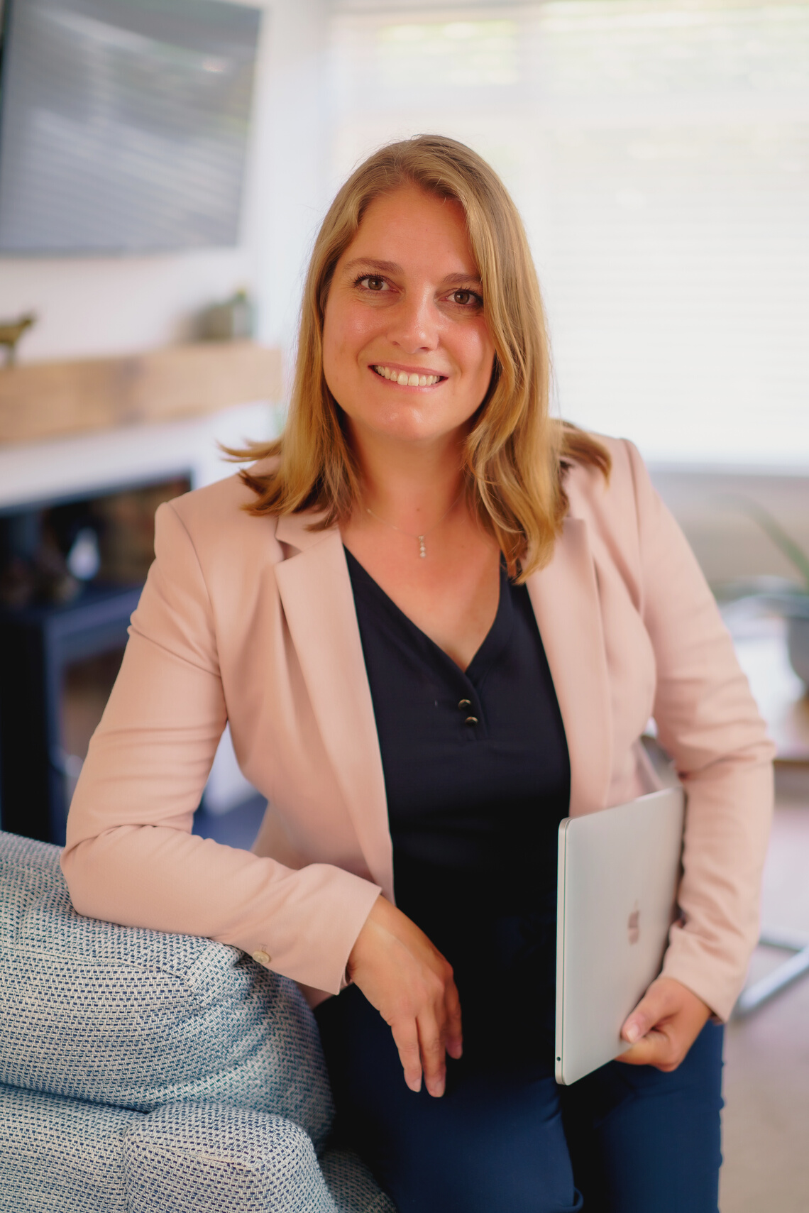
Beat Stress
Create Balance
Find Time
Get off the hamsterwheel of being busy.
Find joy in your work and life again!
Cynthia Moore Coaching

Slide 2
When routine becomes a grind, productivity dips and results tank!
Cynthia Moore Coaching
WE GET STUCK BEING BUSY RATHER THAN PRODUCTIVE. BALANCE IS OUT AND STRESS CREEPS IN.

Slide 3
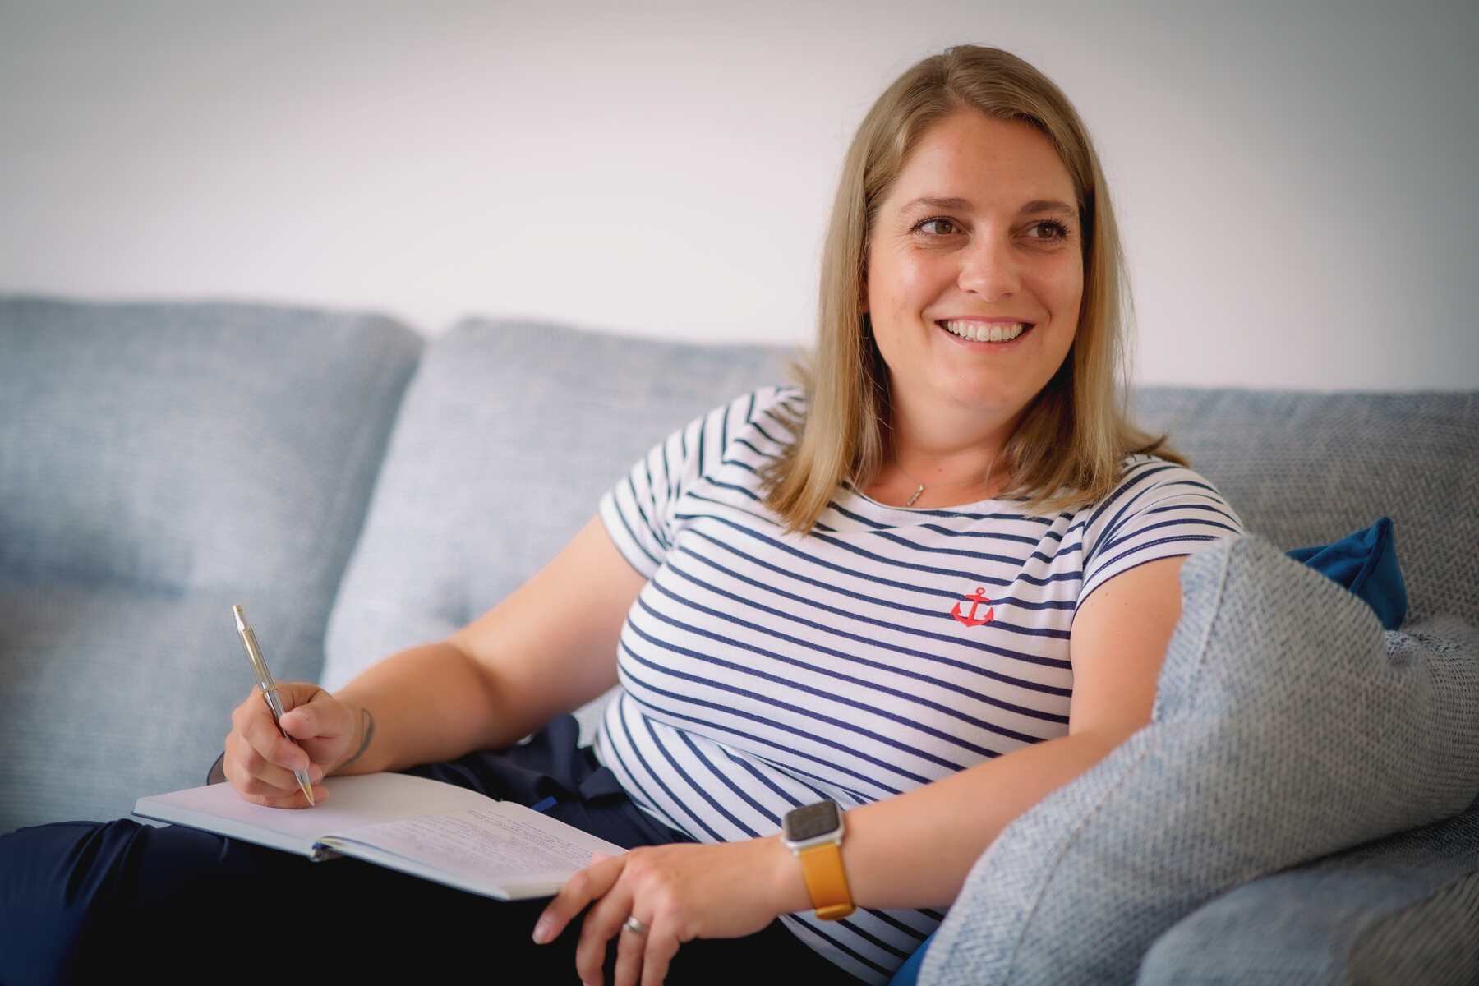
Hi!
I'm Cynthia
Cynthia Moore Coaching
I GOT OFF THE HAMSTERWHEEL
Making different, sometimes difficult choices to take control of my time, my work and my well-being.

Slide 4
EMOTIONAL AND/OR PHYSICAL RESPONSE TO THE EXPERIENCE OF PRESSURE
OFTEN RELATED TO TIME, PERFORMANCE OR EXPECTATION AND A JUDGEMENT MADE ABOUT THOSE
Cynthia Moore Coaching
Stress in a nutshell
STRESS IS CAUSED BY OUR PERCEPTION OF A SITUATION
CAN WE LEARN TO INTERPRET STRESSFUL SITUATIONS DIFFERENTLY?

Slide 5
ANTs
AUTOMATIC NEGATIVE THOUGHT PATTERNS
BINARY THINKING
NEGATIVE BIAS
PRESUMPTIONS & ASSUMPTIONS
CATASTROPHISING
EMOTIONAL THINKING
JUDGEMENT (GUILT/SHAME)
LABELLING
BLAME
Cynthia Moore Coaching

Slide 6
OK...
Now WHAT?
SLOW DOWN! GIVE YOURSELF A CHANCE TO NOTICE WHAT'S HAPPENING.
CREATE SPACE FOR SELF-INQUIRY. CHALLENGE OBJECTIVELY.
Cynthia Moore Coaching
CONSIDER WHICH PARTS ARE WITHIN YOUR CONTROL
"IT'S NOT WHAT HAPPENS TO YOU, BUT HOW YOU REACT TO IT THAT MATTERS"
DETERMINE WHAT SMALL ACTION YOU CAN TAKE NOW TO MOVE FORWARD
EPICTETUS

Slide 7
What does Balance look like to you?
A BIG TO DO LIST?
BUSY YET NOT ACHIEVING?
SENSE OF OVERWHELM?
BEING DRIVEN BY EVENTS AND CIRCUMSTANCES?
FEELING RUDDERLESS?
Cynthia Moore Coaching
HAVING A HANDLE ON ALL ELEMENTS IN YOUR LIFE.
A Sense of being Calm, clear-headed, motivated, capable and present.

Slide 8
Where to look?
MIND:
CHALLENGING, LEARNING VS REST
Cynthia Moore Coaching
EMOTIONALLY:
GIVING TO OTHERS VS RECEIVING
PROFESSIONALLY:
ACHIEVEMENT VS ENJOYMENT
FAMILY / SOCIALLY:
RESPONSIBILITIES VS BOUNDARIES

Slide 9
ARE YOUR EXPECTATIONS REALISTICALLY SET?
Create Balance
CAN YOU PRIORITISE YOURSELF? IN TERMS OF TIME, ATTENTION, INTEGRITY ETC
Cynthia Moore Coaching
WHAT ARE YOUR KEY VALUE-ADD ACTIVITIES? WHAT DOES 'VALUE-ADD' MEAN TO YOU?
THINGS TO CONSIDER WHEN BALANCE IS LACKING
DETERMINE WHAT SMALL ACTION YOU CAN TAKE NOW TO MOVE FORWARD

Slide 10
Is time fixed?
SOME DAYS FEEL GREAT! YOU'RE GETTING SO MUCH DONE, EVERYTHING IS FLYING!
Cynthia Moore Coaching
OTHER DAYS ARE LIKE WADING THROUGH TREACLE.
YET OUR TIME CONSTRUCT IS THE SAME.
WHAT CHANGED?

Slide 11
Perceiving Time
AS WE TRY TO CONTROL TIME BY CREATING STRUCTURES, THE PRESSURE INCREASES TO MAKE THE MOST OF OUR TIME.
Cynthia Moore Coaching
PRODUCTIVITY SHAME FEEDS TIME ANXIETY.
THIS CAN CAUSE PROCRASTINATION, OVERWHELM, DISTRACTION AND WORSE.
LEADING TO A SENSE OF 'BUSYNESS' AND LACK OF TIME.

Slide 12
ACKNOWLEDGE TIME AS IT IS. FOCUS ON WHAT YOU CAN DO NOW, IN THE PRESENT
WHAT ACTIVITIES ARE TIME WELL-SPENT? WHAT DOES A GOOD DAY LOOK LIKE?
Cynthia Moore Coaching
Flexing time
CONSIDER THE BALANCE IN THE DIFFERENT ELEMENTS OF LIFE. ARE YOU PRIORITIES ALIGNED?
HOW OFTEN DO YOU USE 'TOO BUSY, NO TIME' AS AN EXCUSE?
NOTICE YOUR LANGUAGE (SPOKEN/THOUGHT) AND REFRAME TO A POSITIVE

Slide 13
AMPLIFYING YOUR AWARENESS OF AUTOMATIC THOUGHTS, ENABLES SELF-INQUIRY
Automatic Thoughts occur in our 'blind spot'
AWARENESS
INQUIRE
REFRAME
REFOCUS
Cynthia Moore Coaching
THAT WILL ALLOW YOU TO REFRAME AND REFOCUS, EMPOWERING YOU TO BE PRO-ACTIVE

Slide 14
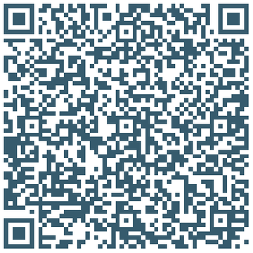
Cynthia Moore
EXECUTIVE COACH
LEADERSHIP SKILLS DEVELOPMENT
BUSINESS CHANGE
STRUCTURE & PROCESS DEVELOPMENT
COACHING & MENTORING
Cynthia Moore Coaching
CONTACT & CONNECT
INFO@CYNTHIAMOORECOACHING.CO.UK
HTTPS://CYNTHIAMOORECOACHING.CO.UK
CONNECT ON LINKEDIN

